Slide 1

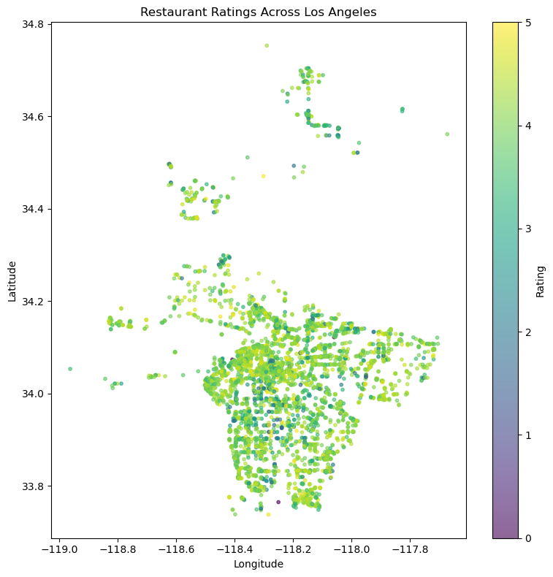
Analyzing the Factors Influencing Restaurant Ratings in Los Angeles
Lauren Yu

Slide 2
INTRODUCTION
Goal: Identify what factors influence restaurant ratings across Los Angeles.
Methods:
  Cleaned + merged using coordinates and ZIP codes
  Exploratory analysis of ratings by cuisine, neighborhood, and demographics
  Correlation + feature importance to find key predictors
Models: Multiple Linear Regression & Random Forest using price level, review volume, cuisine type, and demographic factors
Purpose: Understand how community characteristics and restaurant attributes drive rating patterns across LA.

Slide 3
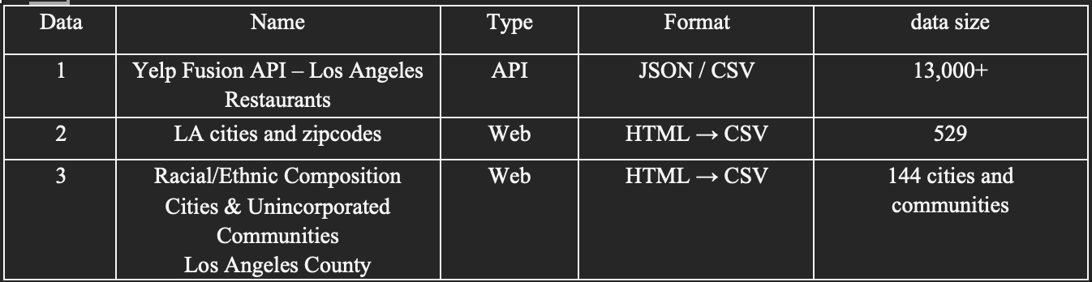
Data Sources

Slide 4
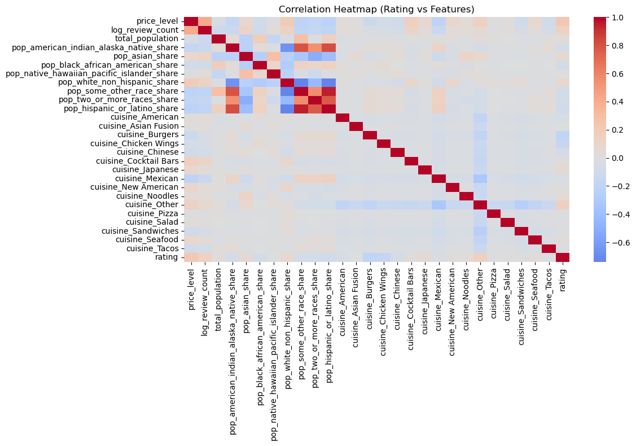
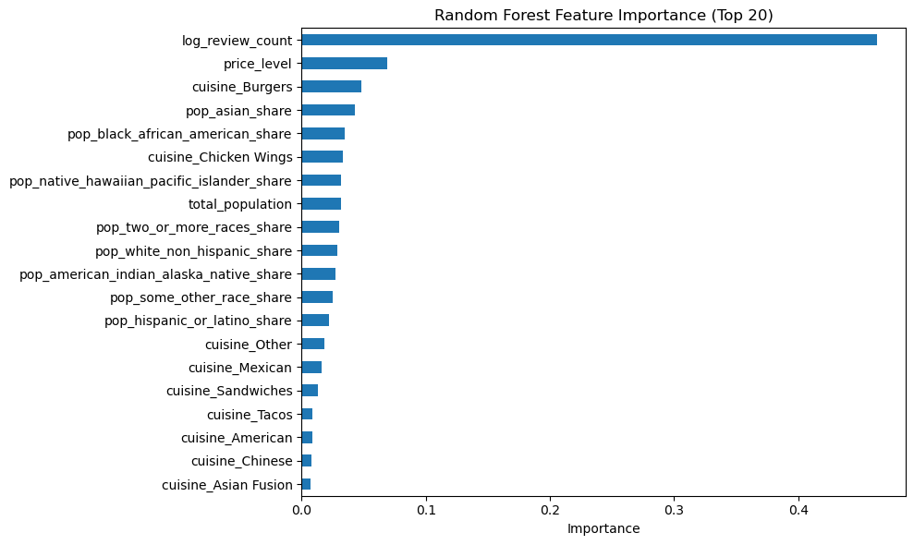
Key Drivers of Restaurant Ratings
Restaurant-level factors are the strongest predictors of Yelp ratings.
Higher price level → higher average ratings
Higher review count → higher ratings (popularity/visibility effect)

Slide 5
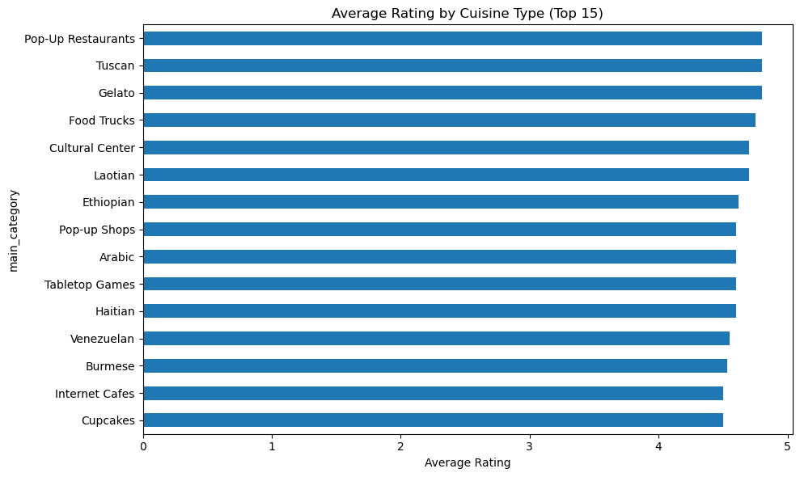
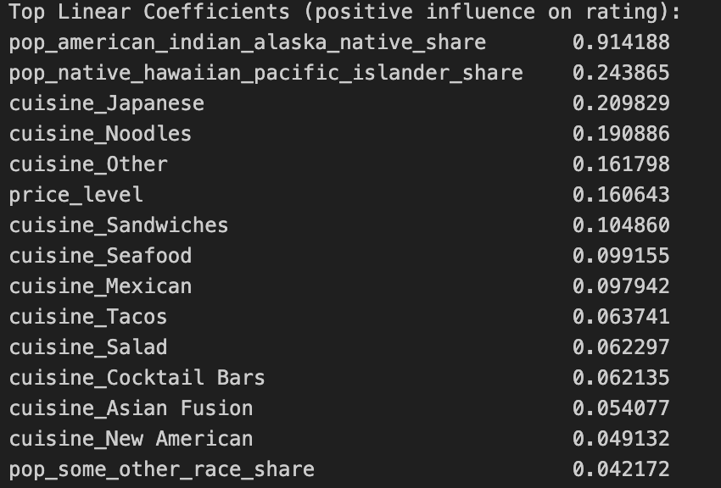
Influence of Cuisine Type
Top cuisines like Pop-Up Restaurants, Tuscan, Gelato, Laotian, Ethiopian consistently have ratings between 4.5–5
Several cuisine dummies are among the highest positive or negative coefficients and cuisine-driven effects remain strong even after controlling for price & visibility
Customer preferences vary significantly by cuisine—certain cuisines systematically receive higher ratings across LA

Slide 6
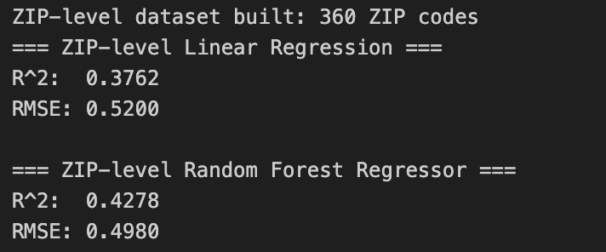
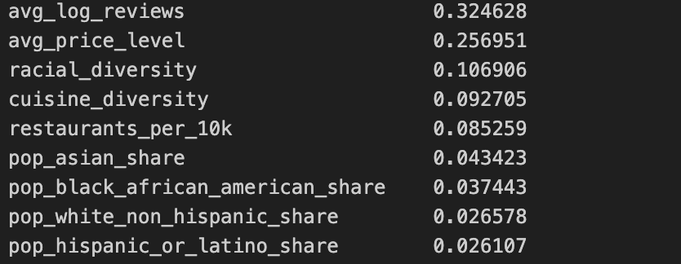
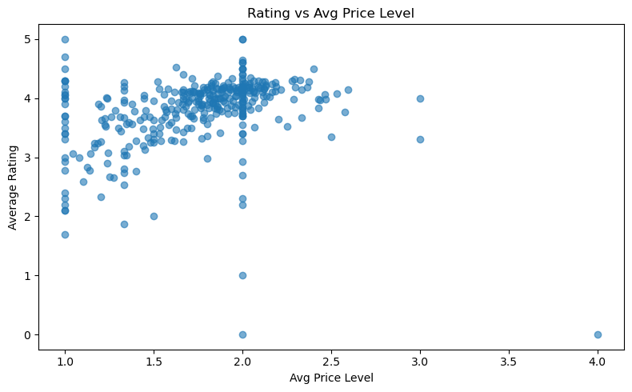
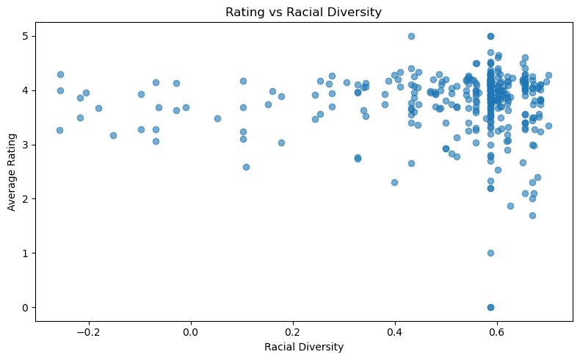
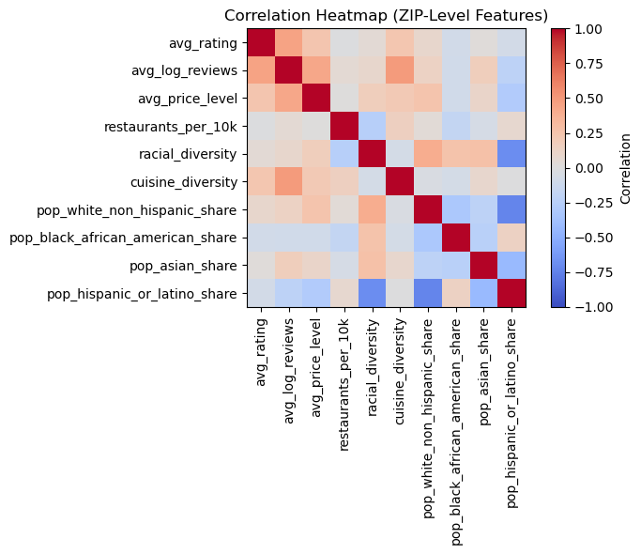
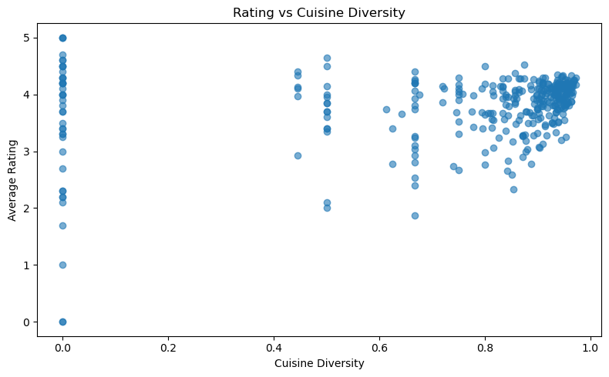
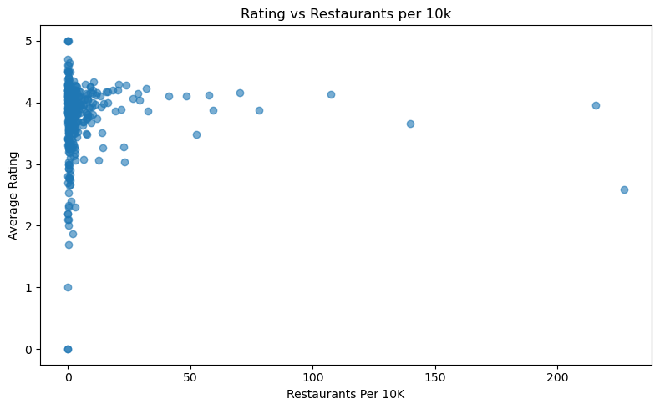
ZIP-Level Aggregation Reveals Stronger Patterns

Slide 7
Summary
Restaurant ratings in Los Angeles are primarily driven by restaurant-level factors such as price level, popularity, and cuisine type, as demonstrated by feature importance plots and correlation matrices. Neighborhood demographic variables show minimal influence at the individual restaurant level, but become meaningful at the ZIP-code level, where diversity and restaurant density moderately predict higher average ratings. Geographic visualizations reveal clear spatial clustering, with several LA regions consistently outperforming others in dining quality. Overall, the analysis shows that both micro-level restaurant characteristics and macro-level neighborhood environments contribute to restaurant performance.

Slide 8
CHALLENAGEs
• Yelp categories needed extensive cleaning.
• City name inconsistencies -> NaN issues during merging.
• Spatial reasoning required for ZIP/city analysis.
• Large dataset required careful preprocessing.

Slide 9
Thank you!

